Slide 1
State Machine Diagram

Slide 2
State
An object’s state is the condition in which it exists
Through the values of its attributes
It can be a passive quality that us used to decide the what the object will do when methods are invoked
It can also be an operation that object executes

Slide 3
State Machine Diagram
An object’s behavior may change based on its state
Its helpful to model such states and the events causing changes
State machine diagram can be used for modelling this behavior
Part of the logical view of the system
Useful in various field such as mathematics, AL, games etc
The system that a state diagram represent will always have finite amount of states, that is why system is also known as finite state machine(FMS)

Slide 4
State
A state is drawn as a rounded rectangle
Name starts with a capital letter, at the top
May have several compartments to represent other properties of the state
State diagrams usually have initial pseudo state and a final state
Represent start and end points of the state machine

Slide 5


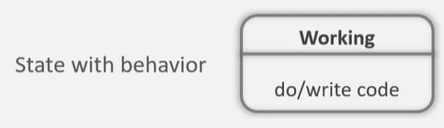

State

Slide 6
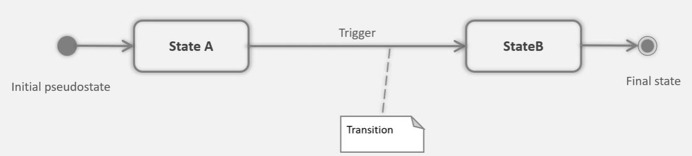
Transition
Represent the change from one state to the other
Transition are drawn as arrows connecting states
A trigger causes a state change and is optionally written alon the transition arrow

Slide 7

Transition Description
Describes the cause of the state change
Each element is optional
Trigger: event that may cause the transition
[guard]: Boolean condition that allows/disallows the transition
Behavior: activity that executes while the transition is taking place

Slide 8
Transition & Triggers
The event will be triggered if
The action is performed
The guard condition evaluates to true
The internal behavior of the state completes

Slide 9
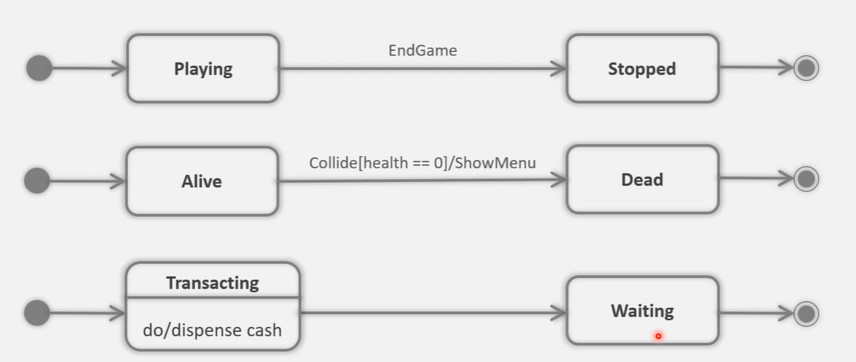

Slide 10
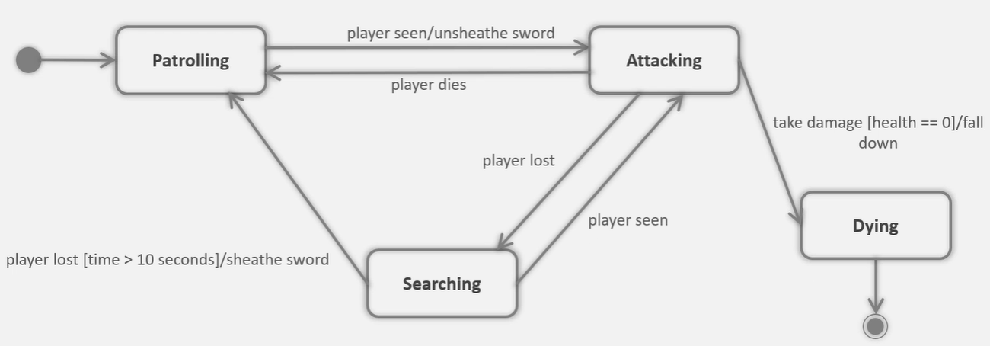

Slide 11
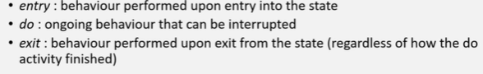
Internal state behavior
A state can list internal actions or state (do) activates that are performed in that state
These are represented through following labels

Slide 12
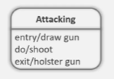
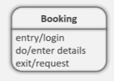

Slide 13
Self Transition
A self transition is a transition that starts & ends in the same state
It is shown with an arrow starting & pointing to the same rectangle
Self transition indicates the behavior whose execution leads to the same state e.g. health –kit pickup
A self transition will cause the state to go through enter & exit behaviors again

Slide 14
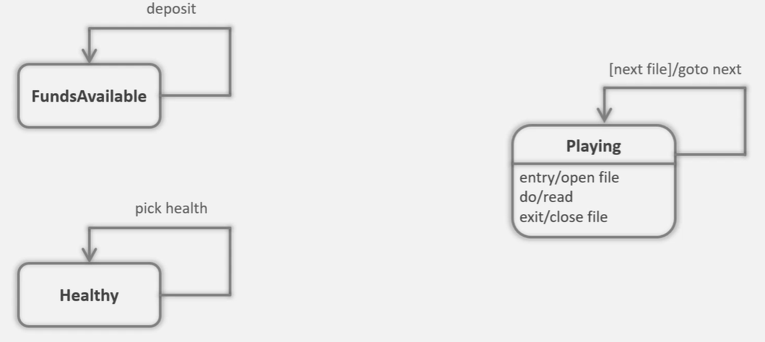

Slide 15
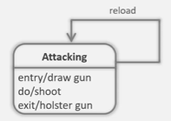
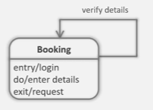
Internal transition
Internal transition is similar to self transition except the entry and exit behavior do not execute

Slide 16
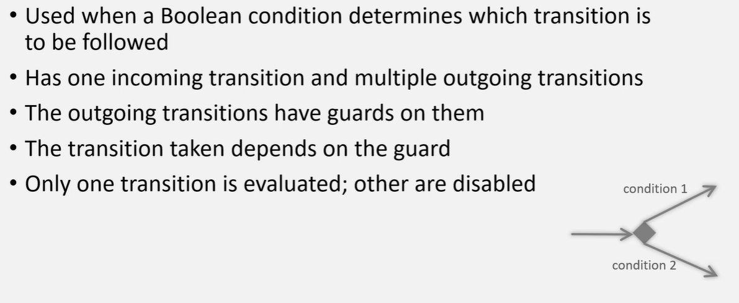
Choice pseudo state

Slide 17
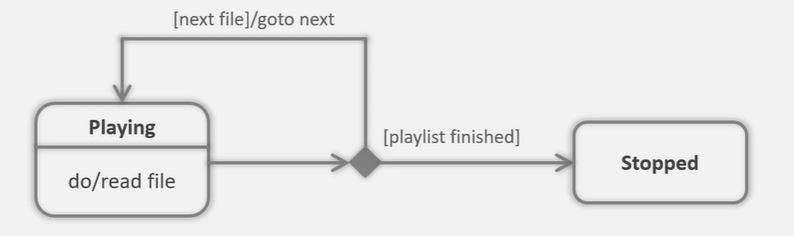
Example

Slide 18
Concurrent State
Concurrent states executes concurrently
Concurrent states are represented by fork and join pseudo sate
Forks breaks the incoming transition into current transitions
Join merges concurrent incoming transition into a single transition

Slide 19
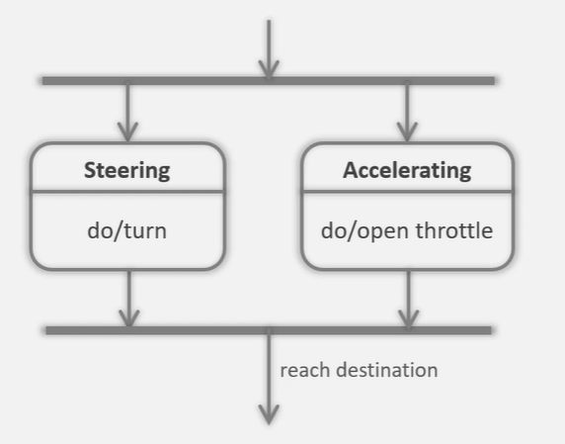
Example

Slide 20
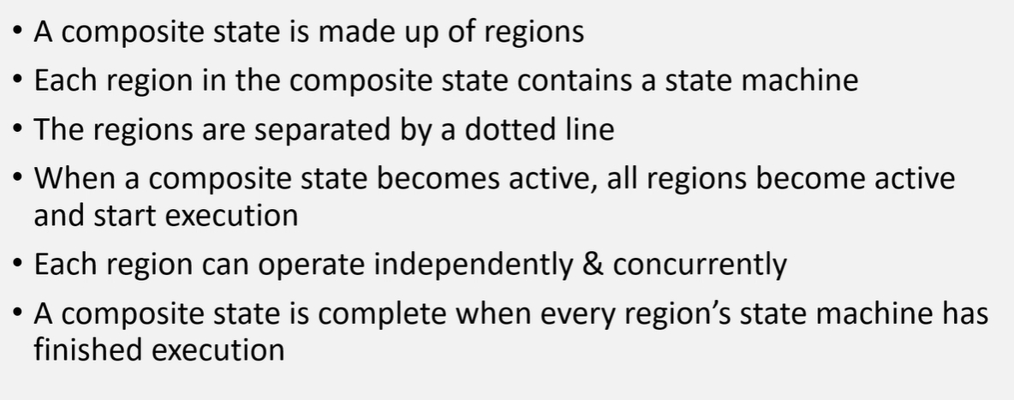
Composite State

Slide 21
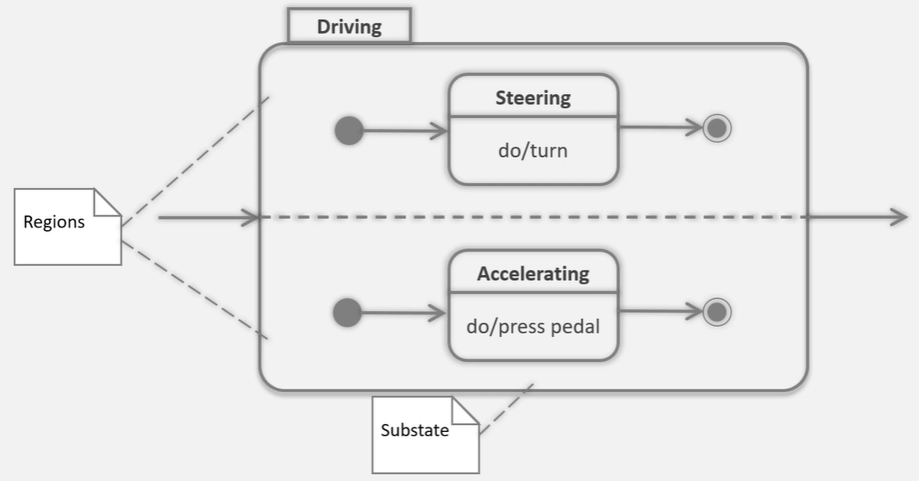
Example

